Slide 1
Design Patterns
Andrey Dobrikov
January 2024

Slide 2
Agenda
01. Introduction
02. SOLID
Goals & Tools
General guidelines for good code
03. Design Patterns Families
04. Design Patterns Intro
05. What is next?
All design patterns tied to one of a three groups
A taste of different design patterns
Learn & Integrate common design patterns
January 21, 2024

Slide 3

Introduction
Each day presents us with fresh challenges that demand resolution.
As our experience grows, we can solve those challenges much faster.
But what if I told you:
Your solution is not perfect
You are not the only one facing such challenges
Men gathered and provided tools for solving those challenges even if we don’t have experience
Without further ado – Design Patterns

Slide 4

SOLID

Slide 5

“A solid idea is a firm foundation of a universe construction.” ― Toba Beta

Slide 6
SOLID serves as a set of guiding principles, offering direction for writing effective code.
Single Responsible Principle
Open - Close Principle
Liskov Substitution Principle
Interface Segregation Principle
Dependency Inversion Principle

Slide 7
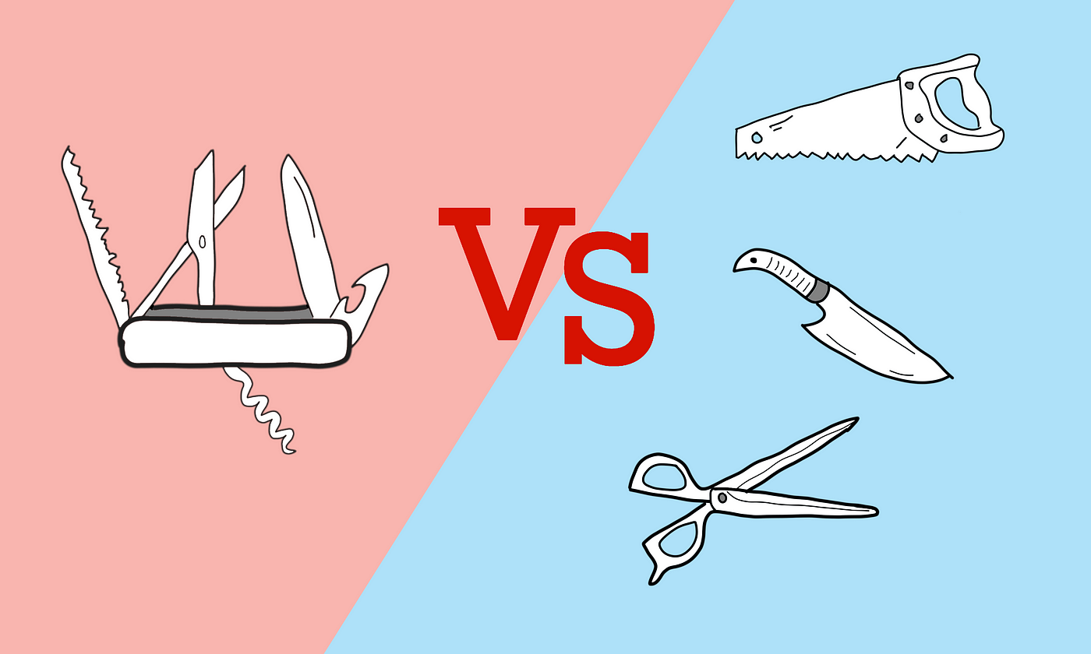
Single Responsible Principle
Principle
Class focused – Single Functionality
A class addresses a specific concern
There should never be more than one reason for a class to change
Bad Example
Changes
A class that is communicating with this server. It has:
- JSON formatter
- Http connection manager
- Some authentication method
Connection is no longer an HTTP
Switch from JSON to XML
Authentication change
Each such update in the architecture will result in a change in this class

Slide 8

Open - Close Principle
Principle
Classes, Modules, Methods, etc... should be
OPEN for extension, but CLOSE for modification.
The Base code is already WRITTEN AND TESTED!
The Base code is opened for extension, and hence the new code car override it.
Example
A base class that has some common fields Person
id
name
age
some abstract methods. (behavior that will change between instances).
An extend class that will add Citizen
Address
phonecall

Slide 9
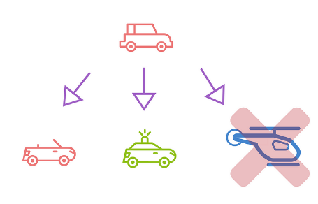
Liskov Substitution Principle
Principle
Functions that use pointers or references to base classes must be able to use objects of derived classes without knowing it.
Extended class should not change the logic of a base class.
Example
Rectangle has height & width, and setters.
A Square is a Rectangle where height = width.
We may think that a Square can extend a Rectangle and use it fields and functions (like Area).
But by doing so we may rewrite the setters! as when setting HEIGHT in Square we MUST set WIDTH to be the same!
The problem:
If we test the set width and height (20 and 30), we expect to see 20 and 30! But we will see only 30 as for Square we changed the behavior of the Rectangle!
To avoid this problem, we may create a Shape interface and put there a function for Area. This was we wont brake base shapes.

Slide 10
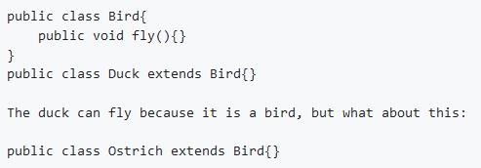
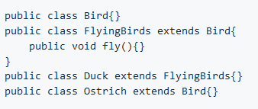
Liskov Substitution Principle – CNT
Bad Example
Example

Slide 11
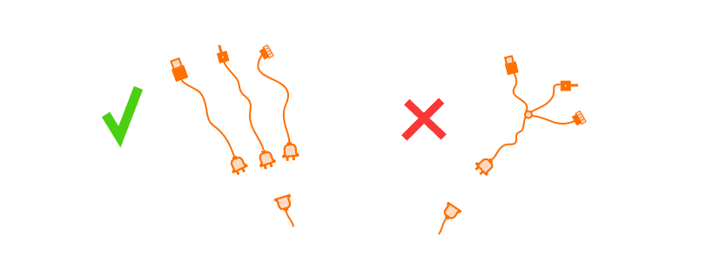
Interface Segregation Principle
Principle
Clients should not be force to depend upon interfaces that they don't use
Interface pollution:
Large Interfaces
Unrelated Methods
Example
GeneralCoolInterface:
drive()
eat()
play()
Will lead to:
Classes with empty method implementations
Methods with UnsupportedOperationException
Method implementation with nulls or dummy values

Slide 12
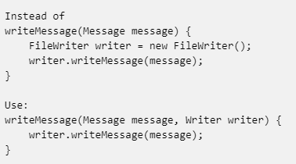
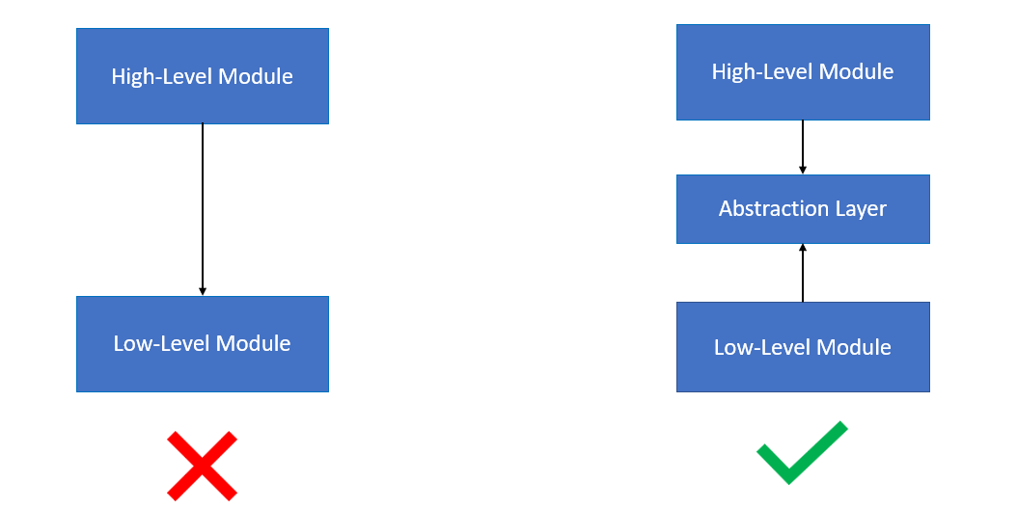
Dependency Inversion Principle
Principle
High level module SHOULD NOT depend on low level module
High level module - provides business rule
Low level module - functionality (like write on disk)
High level should not make tightly couples and depend on abstraction
Example
Instead of using new instance of FileWriter we can create an interface and let the high level to use this interface

Slide 13
Design Patterns Intro

Slide 14

“The best designers will use many design patterns that dovetail and intertwine to produce a greater whole.” ― Erich Gamma

Slide 15
Design Patterns can be divided to 3 main categories
Creational
Structural
Behavioral

Slide 16

Creational
Responsibility
Deals with the process of creation objects of classes
Examples
Factory
Builder
Singelton

Slide 17
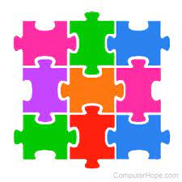
Structural
Responsibility
Deals with creation of compose objects.
How to arrange classes and objects so functionality can be derived from them.
Examples
Adapter
Decorator
Proxy

Slide 18
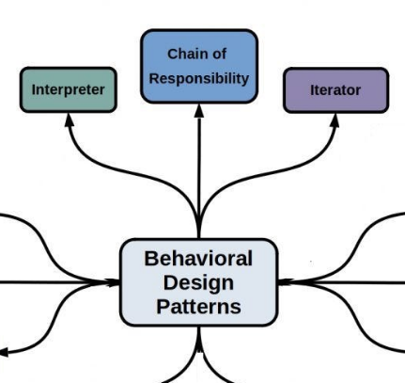
Behavioral
Responsibility
Inter-Communication and interaction of classes and objects to derive the functionality
Examples
Iterator
Observer
Strategy

Slide 19
Creational
Creational design patterns provide various object creation mechanisms, which increase flexibility and reuse of existing code

Slide 20
Structural
Structural design patterns explain how to assemble objects and classes into larger structures, while keeping these structures flexible and efficient

Slide 21
Behavioral
Behavioral design patterns are concerned with algorithms and the assignment of responsibilities between objects

Slide 22
Summary
Our business is good
Our customers keep coming back
We’re getting our work done
We’re leaders
We’re delivering for our customers

Slide 23

Thank you
Keep the good work and keep aiming higher!
Andrey Dobrikov

